Slide 1
Book Recommendation System
Jaypee University Of Engineering and Technology
TEAM MEMBERS
LOKENDRA SAHU 221B221
MAHIPAL PRATAP SINGH TOMAR 221B225
MANOJ KUMAR LODHA 221B231
Project no : AK6
Guided by : dr. aJAY kUMAR

Slide 2
Content
Introduction
Requirement analysis
Block diagram of project
Result
Conclusion
Infosys Springboard Courses

Slide 3
Introduction
Data Science is a field that involves using scientific methods, algorithms, and systems to extract knowledge and insights from structured and unstructured data. It combines statistics, mathematics, programming, and domain expertise to solve complex problems.
Applications of Data Science:
Healthcare: Predicting disease outbreaks, personalized medicine, and improving patient care.
Finance: Fraud detection, risk management, and algorithmic trading.
Retail: Customer behavior analysis, inventory management, and recommendation systems.
Transportation: Optimizing routes, predicting traffic patterns, and autonomous vehicles.

Slide 4
Introduction
In the vast universe of books, finding the perfect read can be both exciting and overwhelming. But fear not! Our data science project aims to create a personalized guide—a literary compass, if you will—that points readers toward books they’ll love.
📖 Reader Engagement: Personalized recommendations foster a deeper connection.
💾 Data Utilization: Leveraging datasets like Goodreads enhances suggestions.
In the vast universe of books, finding the perfect read can be both exciting and overwhelming. But fear not! Our dd books they’ll love.

Slide 5
Requirement analysis
Data Source: Utilizes a rich dataset from Goodreads.
Techniques Used: Involves data preprocessing, feature extraction , some NLP techniques like tf-idf matrix and cosine similarity
Methodology: Employs collaborative filtering to create personalized book suggestions.
Tools Utilized: Leverages Python, Jupyter Lab, and scikit-learn for data manipulation , streamlit for user interface.
Goal: Enhances user experience by providing accurate and relevant book recommendations.

Slide 6
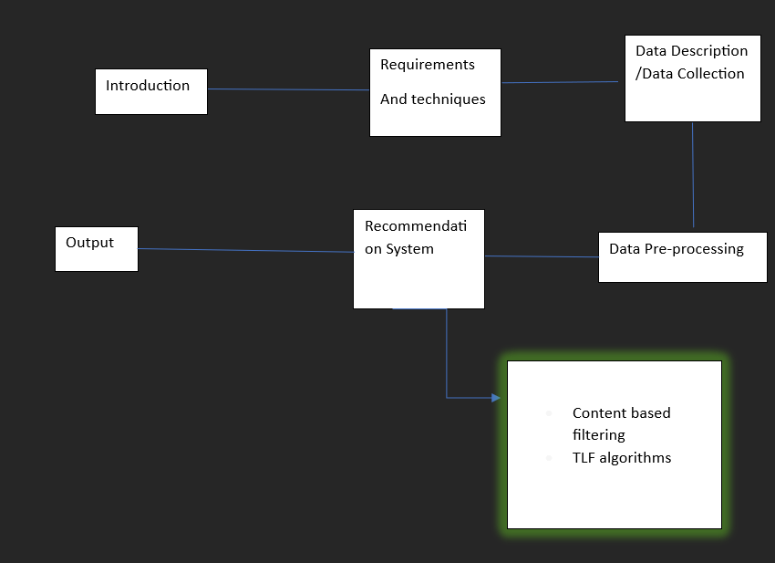
Block diagram
Fig.1 Block diagram

Slide 7
Data Collection
The UCSD Goodreads Dataset is a comprehensive collection of data from the Goodreads book review website, curated by researchers at the University of California, San Diego (UCSD).
Here are some key features of the dataset:
User Interactions: Includes data on user ratings, reviews, and book shelves .
“goodreads_interactions. csv”
Book Attributes: Contains information about books, such as titles, authors, genres, and series.
“goodreads_books. json”
Rich Metadata: Provides additional details like book descriptions and publication dates.

Slide 8
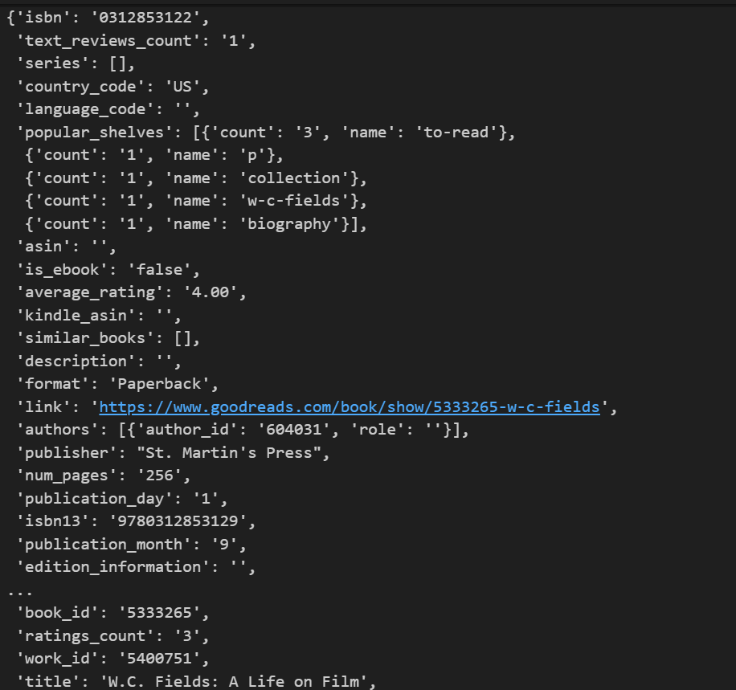
Data Description
1. goodreads_books.json.gz
The file contains all the attributes about the book,
like isbn , text_reviews_count , series, description, link,
Authors, num_pages, book_id etc.
There are large number of attributes in the files.
Fig.2 goodreads_books attributes

Slide 9
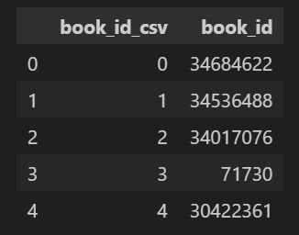
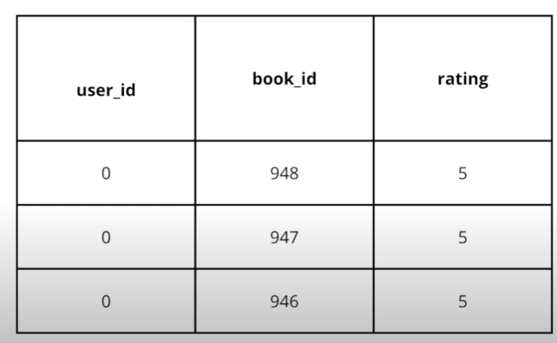
Data Description
2. book_id_map.csv
This file serves as the map for the book id present in the large file of goodreads_book.json, which contain details of the books.
3. goodreads_interactions.csv
It contains the data of the users who liked the books or rated the books.
Fig.3 goodreads_books attributes
4. books_titles.json
It contains only the titles of the books from the goodreads_books.json for the easy fetching of search engine.
Fig.4 goodreads_interactions attributes

Slide 10
Data pre-processing
Normalization: Scale user ratings to a consistent range, making them easier to compare.
e.g. decreased the size of user_interactions file to scale efficiently.
Feature Extraction: Pull useful info like book genres, authors, and ratings from the raw data for the recommendation engine.
Encoding: Convert text (like book genres) into numerical form

Slide 11
Search Engine Functionality
Selecting the attributes that is used in the search query to improvise the new user experience.
using TF-IDF MATTRIX and vectorizer to find the similarity between user query with the books titles existing in the dataset.
provide similar books that matches the query.

Slide 12
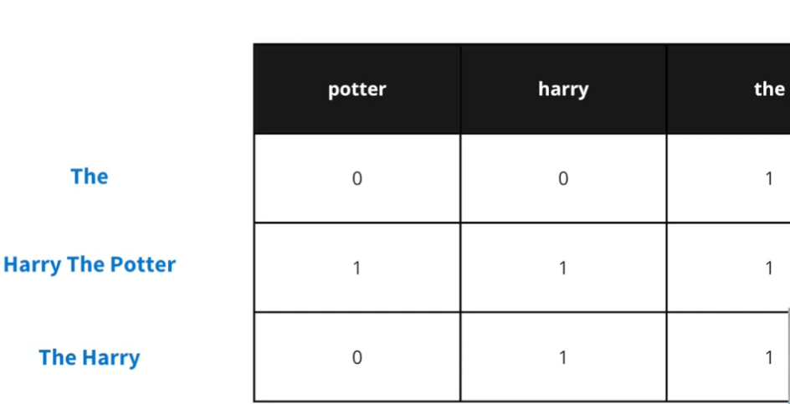
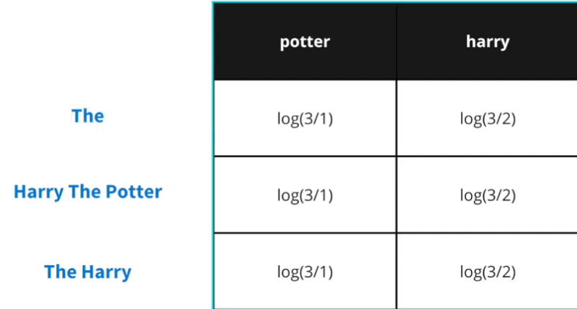
TF and IDF matrix
Fig.5 Inverse document frequency matrix
Fig.6 Term frequency matrix

Slide 13
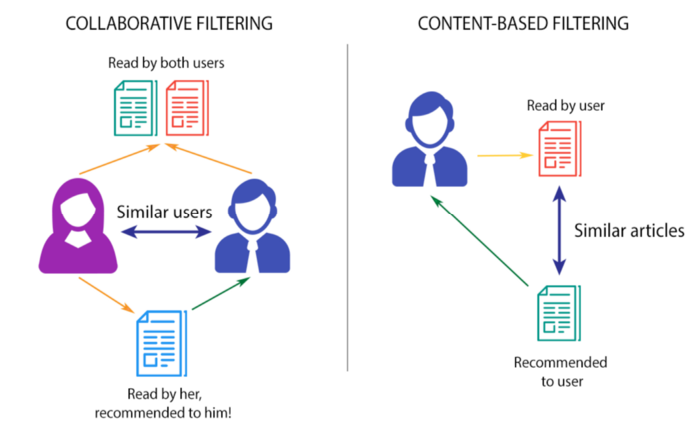
Collaborative Filtering
Collaborative filtering recommendations are based on the opinions of a community of similar users. The basic idea is that users recommend items to one another. Collaborative filtering makes this possible by asking the users to rate items, which allows the system to recommend new items that similar users have rated highly

Slide 14
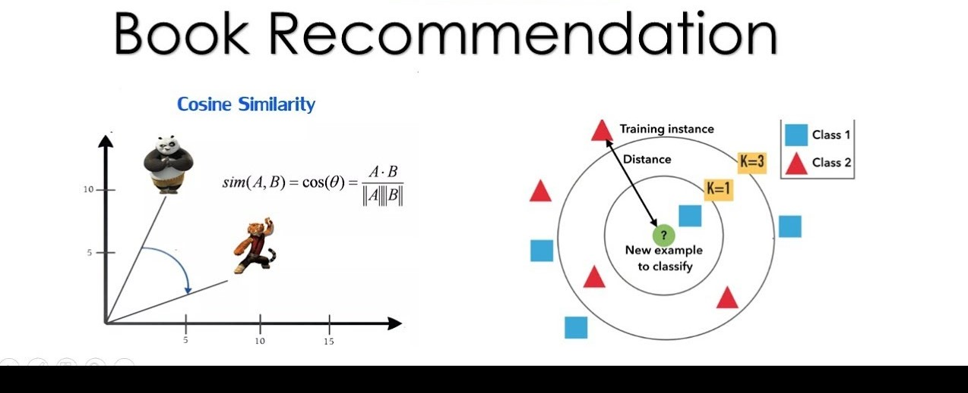
User Similarity Metrics (Cont’d)
Outcome: Identifies users with similar book tastes.
Cosine Similarity compares user preferences by measuring the cosine of the angle between their rating vectors.

Slide 15

Introduction to Interface
Using streamlit – A python framework

Slide 16
What is Streamlit?
Streamlit is an open-source Python framework designed to build data-driven applications quickly and easily. It's particularly popular in the data science community because it allows developers to turn data scripts into interactive web applications with minimal effort.
Key Features:
Ease of Use: You can create an entire web app using just Python, no need for complex front-end development skills.
Real-Time Updates: Streamlit apps automatically update when the underlying code or data changes, making it ideal for interactive dashboards.
Customization: You can integrate custom HTML, CSS, and JavaScript for more control over your app’s appearance.
Interactivity: Allows users to input parameters, explore data visually, and interact with machine learning models.

Slide 17
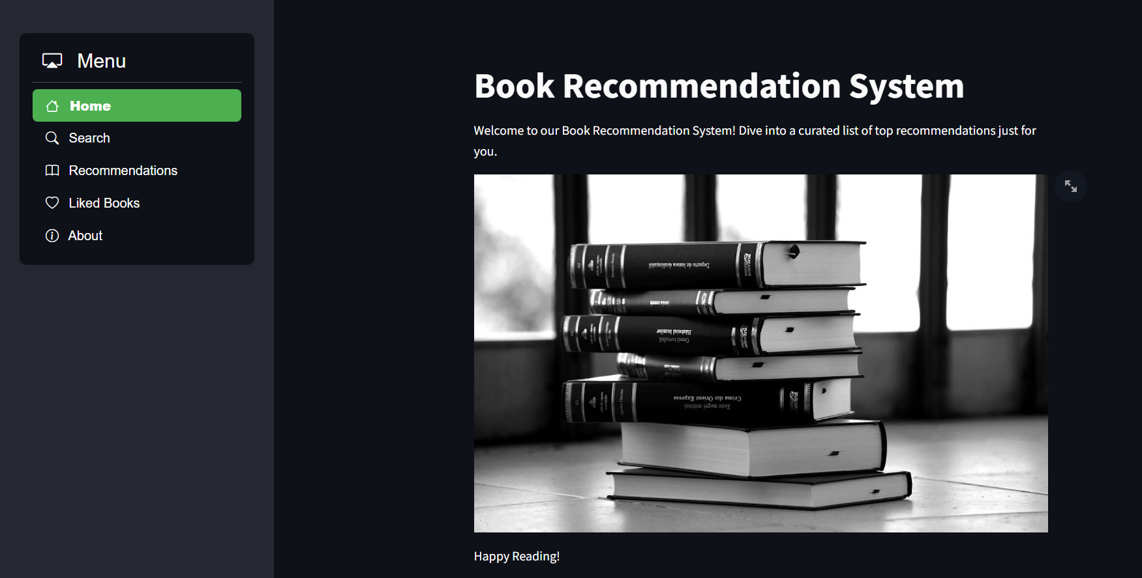
Home page
Here’s a simple glimpse of our project.
Fig.10 home page view

Slide 18
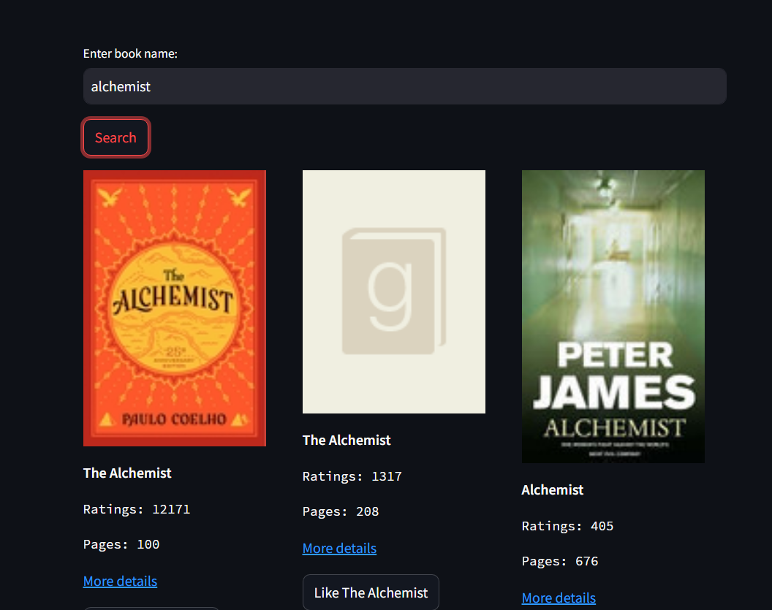

Search and recommendations
Fig.11 search section view
Fig.12 recommend section view

Slide 19
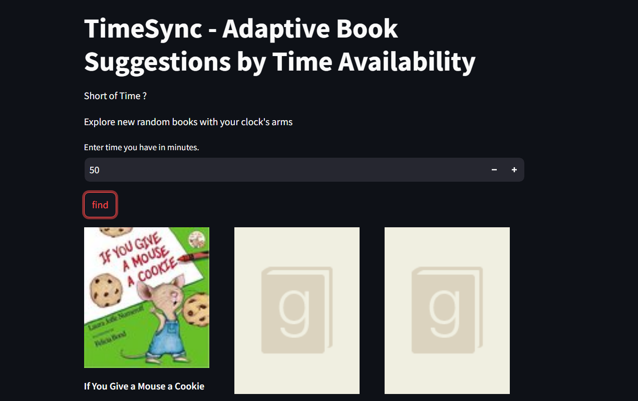
TimeSync
A feature which helps the users to experience random books in the sense of time they have so that they can try something new.
Fig.13 timesync section view

Slide 20
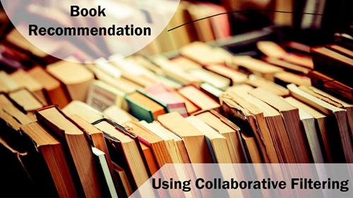
Further Work on the project
To improve the quality of recommendations using
COLLABORATIVE FILTERING – A LEARNING TECHNIQUE

Slide 21
Conclusion
We built a system that uses collaborative filtering to offer personalized book recommendations.

Slide 22
Infosys Springboard Courses
Data science foundation certificate
Introduction to Data Science
Introduction to linear algebra in python.

